Slide 1
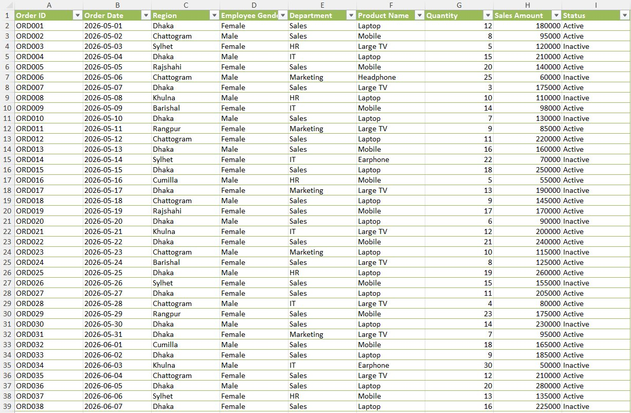
The Dataset

Slide 2
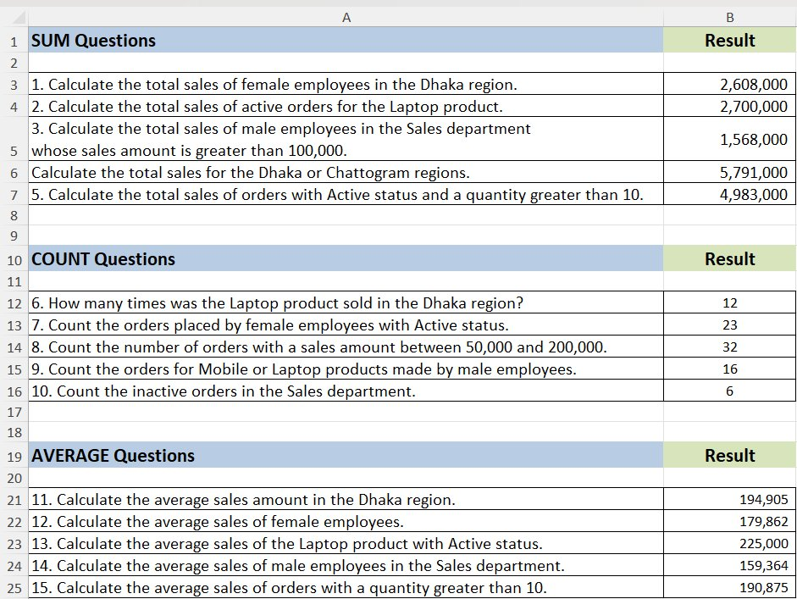
SUM, COUNT & AVERAGE Results

Slide 3
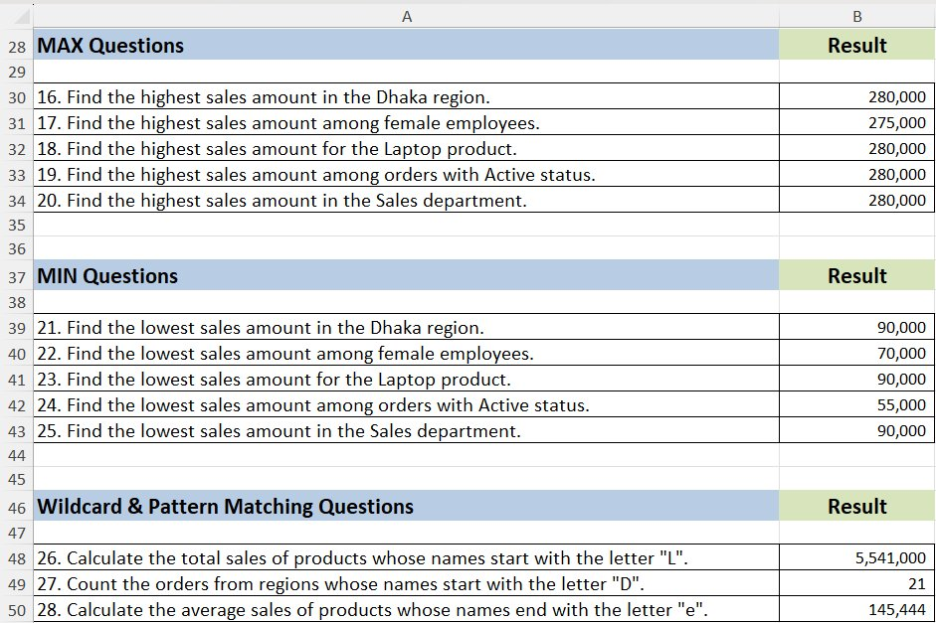
MAX, MIN & Wildcard Pattern Matching

Slide 4
Functions & Skills Practiced
SUM
SUMIF / SUMIFS
Single & multi-condition totals (AND/OR) across region, gender, department, product, status and quantity.
COUNT
COUNTIF / COUNTIFS
Counted orders using single, combined, range (“between”) and OR conditions.
AVERAGE
AVERAGEIF / AVERAGEIFS
Average sales for single and multi-criteria filters across fields.
MAX
MAXIFS
Highest sales amount for each single-condition filter (region, gender, product, status, dept).
MIN
MINIFS
Lowest sales amount for the same set of single-condition filters.
WILDCARD
SUMIF · COUNTIF · AVERAGEIF + “*”
Pattern matching - values starting or ending with a given letter.

